Slide 1



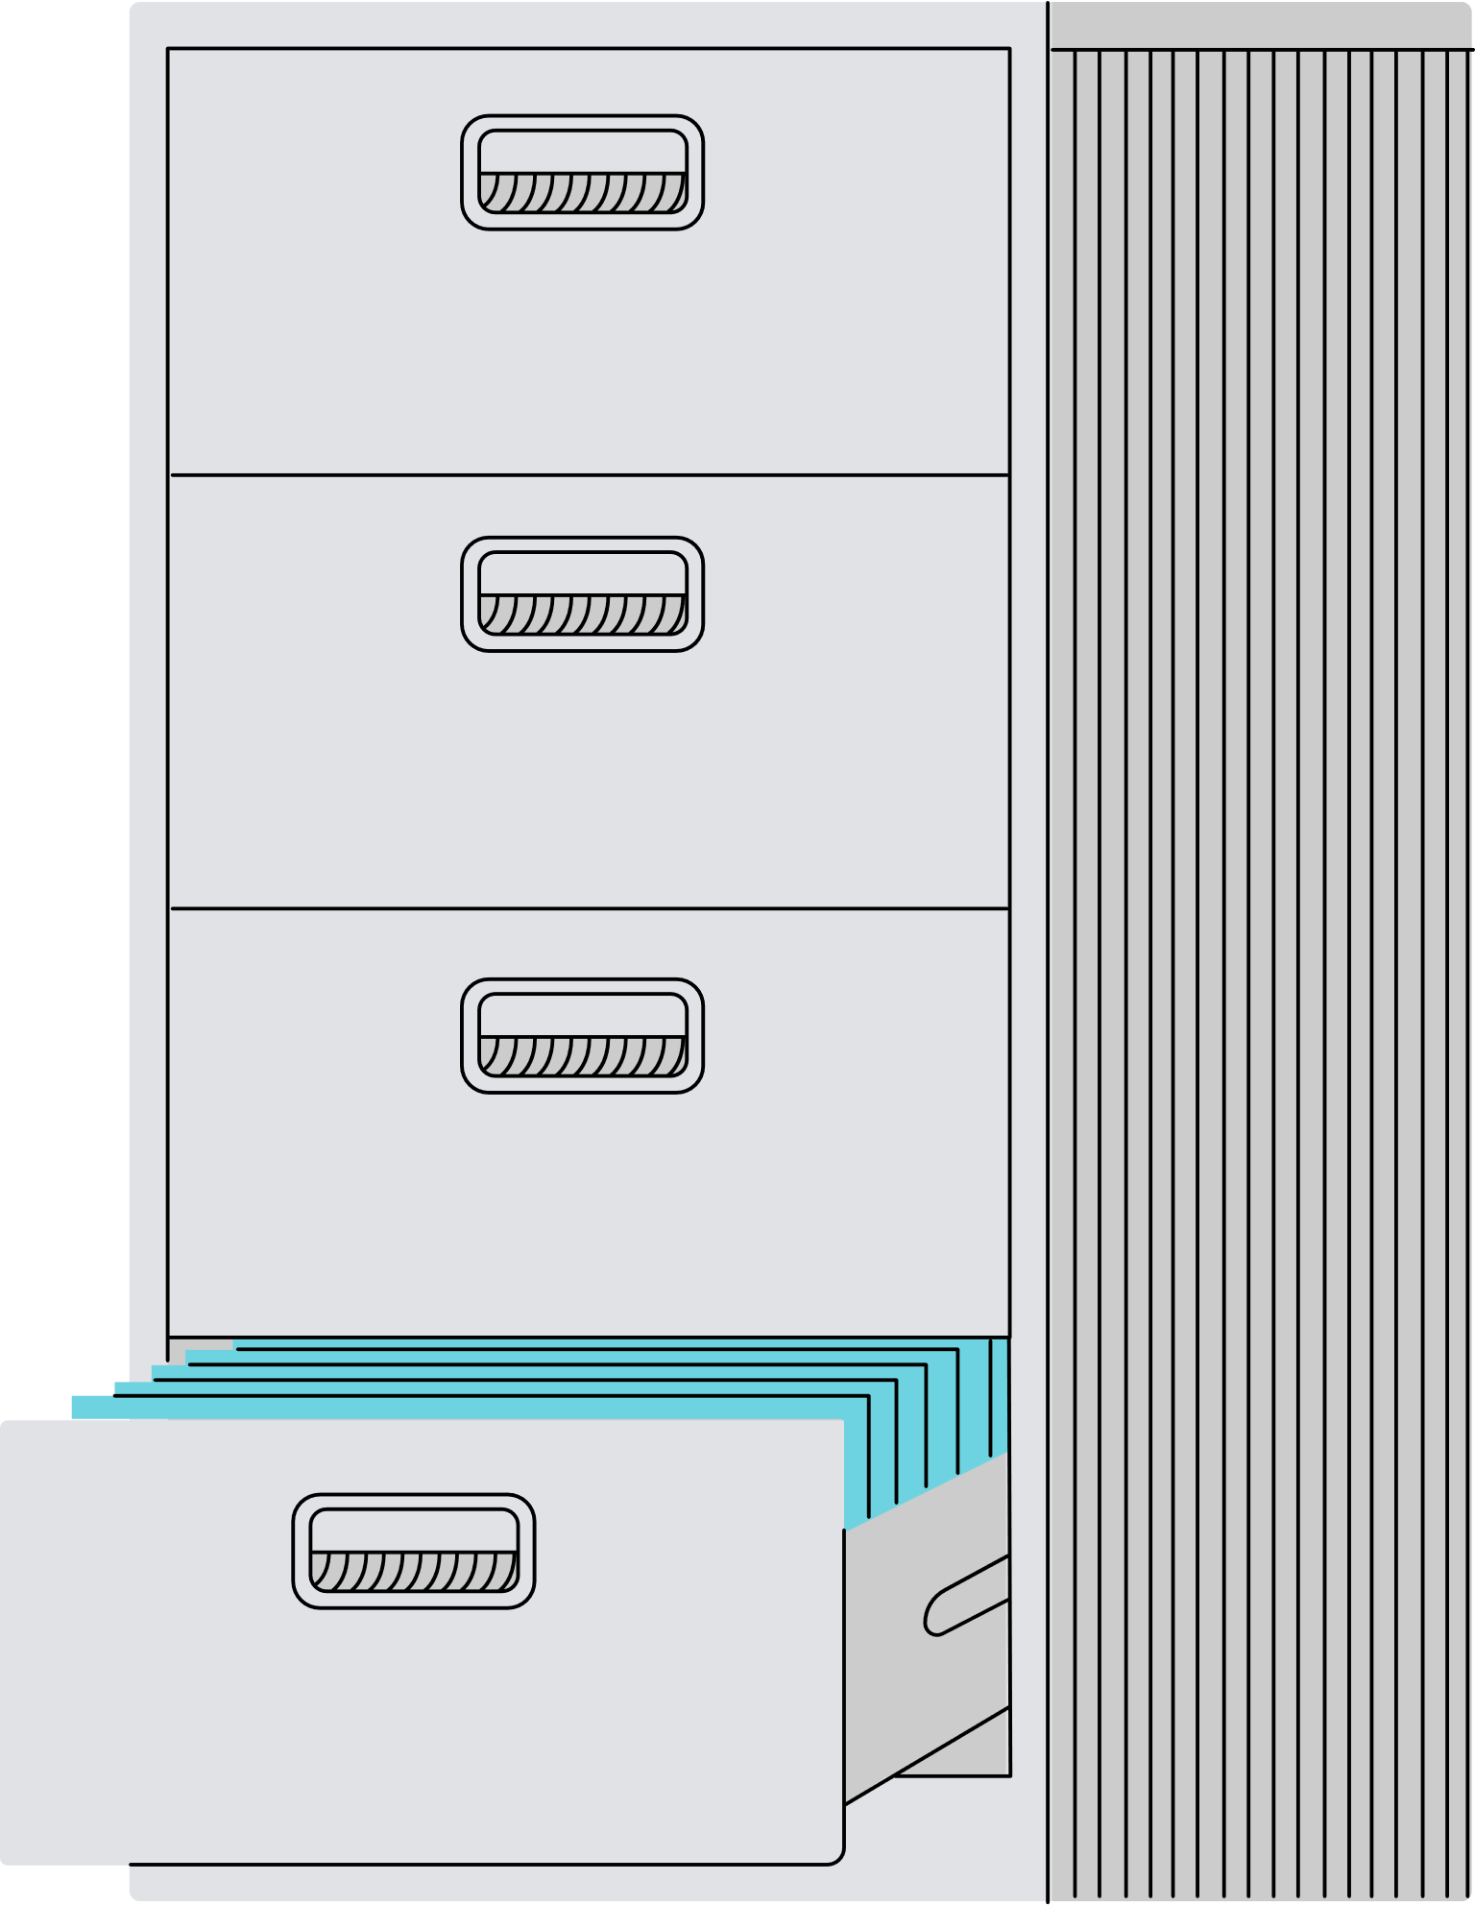



Optimizing Office Space
-By Anvesh

Slide 2





IHUB
Introduction
Challenge: Limited office space for the growing team.
Objective: Identify and implement cost-effective, scalable solutions.

Slide 3


Solution 1:
Flexible Workstations
Use shared desks or hot-desking systems where employees don't have assigned seats.

Slide 4

Solution 1:
Advantages & Disadvantages
Advantages:
Cost-effective, reduces unused desk space.
Encourages collaboration and adaptability.
Disadvantages:
Lack of personalization might reduce employee satisfaction.
Scheduling conflicts could arise.

Slide 5

Solution 2:
Remote Work & Hybrid Model
Allow employees to work remotely part-time or full-time.
Maintain a smaller core team in-office while others operate remotely.

Slide 6

Solution 2:
Advantages & Disadvantages
Advantages:
Frees up significant office space.
Improves work-life balance, boosting productivity.
Disadvantages:
Requires strong communication tools and processes.
May reduce team bonding and collaboration.

Slide 7

Solution 3:
Modular Furniture
Install foldable or stackable furniture that can be adjusted based on needs.
Use movable partitions to create temporary meeting rooms or workspaces.

Slide 8

Solution 3:
Advantages & Disadvantages
Advantages:
Maximizes space utilization.
Customizable for different team sizes or activities.
Disadvantages:
High initial investment.
Frequent adjustments may disrupt workflow.

Slide 9

Solution 4:
Vertical Space Optimization
Use shelves and wall-mounted storage to free up floor space.
Incorporate standing desks to reduce seating requirements.

Slide 10
Solution 4:
Advantages & Disadvantages
Advantages:
Adds storage without increasing footprint.
Creates an organized, clutter-free environment.
Disadvantages:
May require structural changes.
Some employees may find vertical layouts less accessible.

Slide 11

Solution 5:
Coworking Space Partnerships
Rent additional coworking spaces for overflow employees.
Utilize coworking memberships for flexibility.

Slide 12
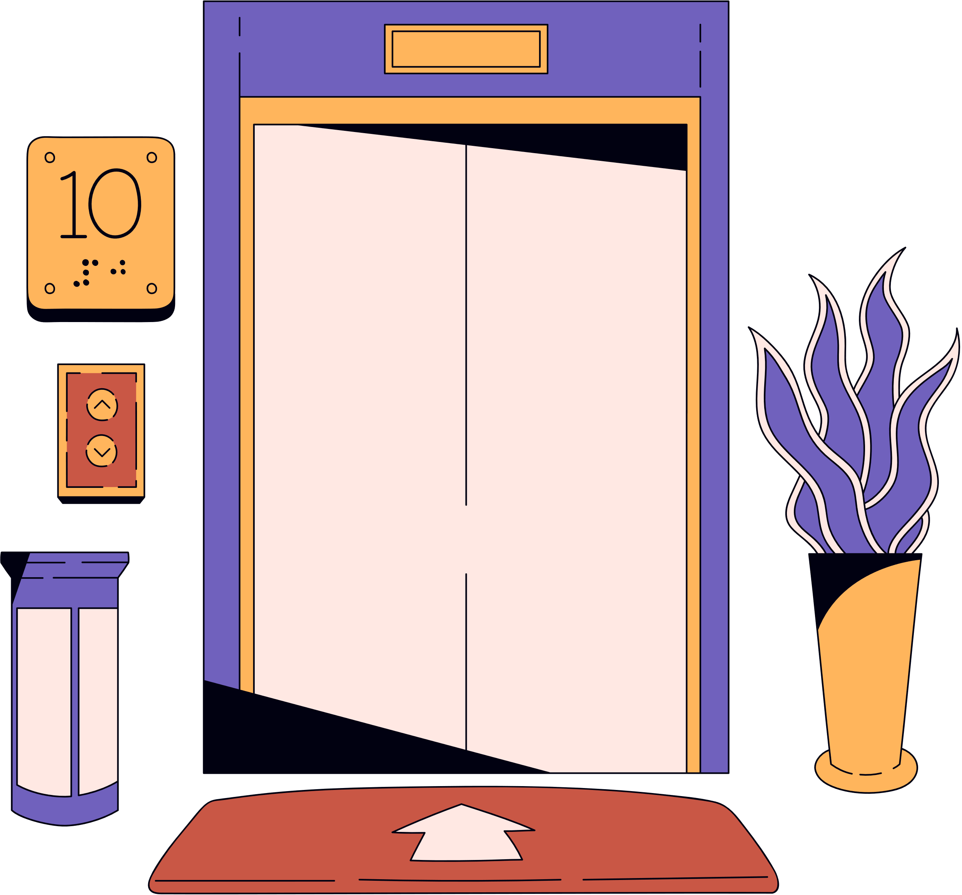
Solution 5:
Advantages & Disadvantages
Advantages:
Scalable and cost-effective in the short term.
Provides networking opportunities.
Disadvantages:
Long-term costs could exceed owning space.
Potential security concerns with shared spaces.

Slide 13

Next steps
Action Plans:
Survey employees for remote work preferences.
Identify and purchase modular furniture.
Implement communication tools and training for remote work.
Pilot and monitor for 3 months to measure effectiveness.

Slide 14
Conclusion
Recommendation:
Hybrid Model combining Remote Work (Solution 2) and Modular Furniture (Solution 3).
Additional Considerations:
Vertical Space Optimization and Coworking Partnerships can supplement growth phases.
Rationale:
Balances cost, scalability, and employee satisfaction while optimizing space.

Slide 15






IHUB
Thank You!
m.anvesh190902@gmail.com
+91 8019342575

